Slide 1
Welcome to EEN1037:
Web Applications Development

Slide 2
Getting Started With Django
Week 5
Joe Mullally

Slide 3
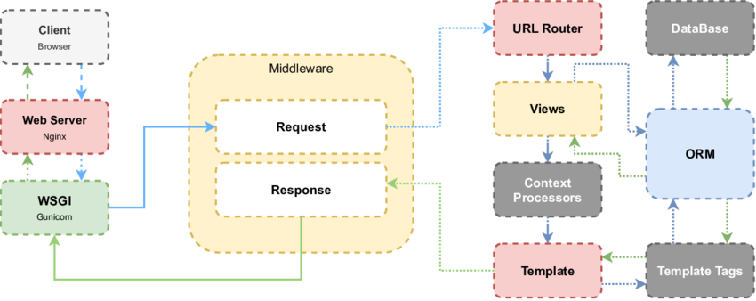
Recap
Overview of Django
But, how do you start a Django project?

Slide 4
Essential Reading
Visual Studio Code
  https://code.visualstudio.com/docs/python/tutorial-django
Django Tutorial
  https://docs.djangoproject.com/en/5.1/intro/tutorial01
  -
  https://docs.djangoproject.com/en/5.1/intro/tutorial04/#write-a-minimal-form (up to up to "Write a minimal form" )

Slide 5
Reference
https://docs.djangoproject.com/en/5.1/topics/
Views:
  https://docs.djangoproject.com/en/5.1/topics/http/views/
Templates:
  https://docs.djangoproject.com/en/5.1/ref/templates/language/
Forms:
  https://docs.djangoproject.com/en/5.1/topics/forms/
  https://developer.mozilla.org/en-US/docs/Learn_web_development/Extensions/Server-side/Django/Forms (up to but excluding ModelForm)
Models:
  https://docs.djangoproject.com/en/5.1/topics/db/models/
  https://docs.djangoproject.com/en/5.1/topics/migrations/

Slide 6
Recommendations
Start with "models.py" and "admin.py"
  It’s fast and establishes your project structure.
Keep it simple:
  Use Function-Based-Views and regular forms.Form classes
  Avoid Class-Based-Views and ModelForm.
  Create single Django application (e.g. "myapp" in the example).
    i.e. no need for multiple "manage.py startapp xyz".
  Look at example projects.
In Visual Studio Code, place breakpoints in your view code for easy HTTP request debugging.

Slide 7
Example Projects
Todo
  Task list
  Very simple example
  Handcrafted HTML forms
  Raw form input processing directly from request.POST with minimal/no validation
Blog
  Posts, Comments, Private Notes
  Medium complexity
  User registration & authentication w/ username
  Staff-only areas
  Function-Based-Views
  Form class for input parsing & validation and fully automatic HTML rendering (form.as_p)
  AJAX calls
eShop
  Products, Categories, Cart, Checkout and Order History
  A little more complex
  User authentication & authentication w/ email
  Staff-only areas
  Function-Based-Views
  Form-class for input validation & partial template rendering with manual layout and styling
  GET based product search filter

Slide 8
Starting Django Project for Assignment
To start your Django project directory:
Follow “Developing Django in Visual Studio Code” PDF on Loop:
  Open new empty project folder in Visual Studio Code
  Source Control -> Initialize Repository
  Create “requirements.txt”
    Django==5.1.7
  F1 → Create Python Virtual Environment → (.venv)
  Create Blank Django Project from command line:
    django-admin startproject mysite .
    manage.py startapp myapp
  Add to mysite/settings.py INSTALLED_APPS:
    “myapp”
  Add to mysite/urls.py urlpatterns:
    path('', include("myapp.urls")),
  Now the project is ready to go
… Or just download and "Django Example Project" starter provided on Loop and open in Visual Studio Code

Slide 9
Implementing Assignment
Part 1: Database Layout
Create your database schema:
Add some database models to "myapp/models.py"
Register those models in "myapp/admin.py"
Start the project:
  manage.py makemigrations
  manage.py migrate
  manage.py createsuperuser
  manage.py runserver
Test the database model functionality in the Admin UI (i.e. http://127.0.0.1:8000/admin )
View your db.sqlite3 database in Dbeaver ( https://dbeaver.io/ )

Slide 10
Example models.py
from django.contrib.auth.models import User
from django.db import models
class Author(models.Model):
name = models.CharField(max_length=100)
birthday = models.DateField()
nationality = models.CharField(max_length=100)
biography = models.TextField(null=True, blank=True)
def __str__(self):
return self.name
class Category(models.Model):
genre = models.CharField(max_length=100)
description = models.TextField()
def __str__(self):
return self.genre
class Book(models.Model):
author = models.ForeignKey(Author, on_delete=models.PROTECT)
title = models.CharField(max_length=100)
year = models.IntegerField()
picture = models.FileField(null=True, blank=True)
blurb = models.TextField(null=True, blank=True)
category = models.ForeignKey(Category, on_delete=models.SET_NULL, null=True, blank=True)
isbn = models.IntegerField()
def __str__(self):
return f"{self.title} by {self.author.name}”
class BookReview(models.Model):
book = models.ForeignKey(Book, on_delete=models.CASCADE)
commenter = models.ForeignKey(User, on_delete=models.CASCADE)
comment = models.TextField()
time_published = models.DateTimeField()
rating = models.IntegerField()
thumbs_up = models.IntegerField()
def __str__(self):
return f"@{self.commenter.username}'s review on {self.book.title}"
class UserProfile(models.Model):
user = models.OneToOneField(User, on_delete=models.CASCADE)
interests = models.TextField()
countrycode = models.CharField(max_length=2)
def __str__(self):
return f"{self.user.username}'s Profile"

Slide 11
Example admin.py
from django.contrib import admin
from .models import Author, Book, BookReview, Category, UserProfile
@admin.register(Author)
class AuthorAdmin(admin.ModelAdmin):
list_display = ['name', 'nationality']
@admin.register(Book)
class BookAdmin(admin.ModelAdmin):
list_display = ['title', 'author__name']
list_select_related = ['author']
@admin.register(BookReview)
class BookReviewAdmin(admin.ModelAdmin):
list_display = ['book__title', 'commenter__username']
list_select_related = ['book', 'commenter']
@admin.register(Category)
class CategoryAdmin(admin.ModelAdmin):
list_display = ['genre']
@admin.register(UserProfile)
class UserProfileAdmin(admin.ModelAdmin):
list_display = ['user__username']

Slide 12
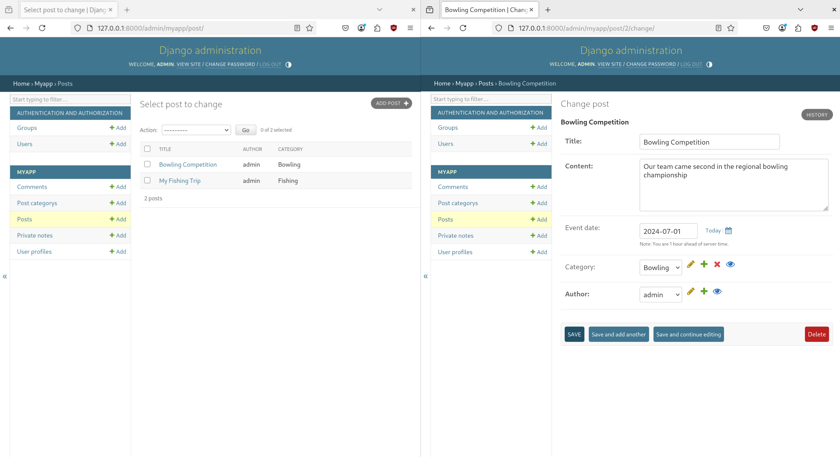
Test Models in Admin UI

Slide 13
Test Models in “manage.py shell”
$ manage.py shell
>>> from myapp.models import Post
>>> all_posts = Post.objects.all()
>>> all_posts
<QuerySet [<Post: My Fishing Trip>, <Post: Bowling Competition>]>
>>> for post in all_posts:
... print(post.title)
...
My Fishing Trip
Bowling Competition
>>> post = Post.objects.get(id=2)
>>> post
<Post: Bowling Competition>
>>> print(post.title)
Bowling Competition
>>> print(post.content)
Our team came second in the regional bowling championship
>>> latest_fishing_post = Post.objects.filter(category__name='Fishing').order_by('-created_at').first()
>>> latest_fishing_post
<Post: My Fishing Trip>

Slide 14
Show Database SQL query logs
In mysite/settings.py:
# Post.objects.get(id=2)
SELECT
"myapp_post"."id",
"myapp_post"."title",
"myapp_post"."content",
"myapp_post"."event_date",
"myapp_post"."category_id",
"myapp_post"."author_id",
"myapp_post"."created_at",
"myapp_post"."updated_at"
FROM "myapp_post"
WHERE "myapp_post"."id" = 2
# Logging
# https://docs.djangoproject.com/en/5.1/topics/logging/
LOGGING = {
"version": 1,
"disable_existing_loggers": False,
"handlers": {
"console": {
"class": "logging.StreamHandler",
},
},
"root": {
"handlers": ["console"],
"level": "INFO",
},
'loggers': {
# Enable Database logging
#'django.db.backends': {
# 'level': 'DEBUG',
# 'handlers': ['console'],
#},
# Enable logging from your application
'myapp': {
'level': 'INFO',
'handlers': ['console'],
}
}
}
# Post.objects.filter(category__name='Fishing').order_by('-created_at').first()
SELECT
"myapp_post"."id",
"myapp_post"."title",
"myapp_post"."content",
"myapp_post"."event_date",
"myapp_post"."category_id",
"myapp_post"."author_id",
"myapp_post"."created_at",
"myapp_post"."updated_at"
FROM "myapp_post"
INNER JOIN "myapp_postcategory"
ON ("myapp_post"."category_id" = "myapp_postcategory"."id")
WHERE "myapp_postcategory"."name" = 'Fishing'
ORDER BY "myapp_post"."created_at"
DESC LIMIT 1

Slide 15
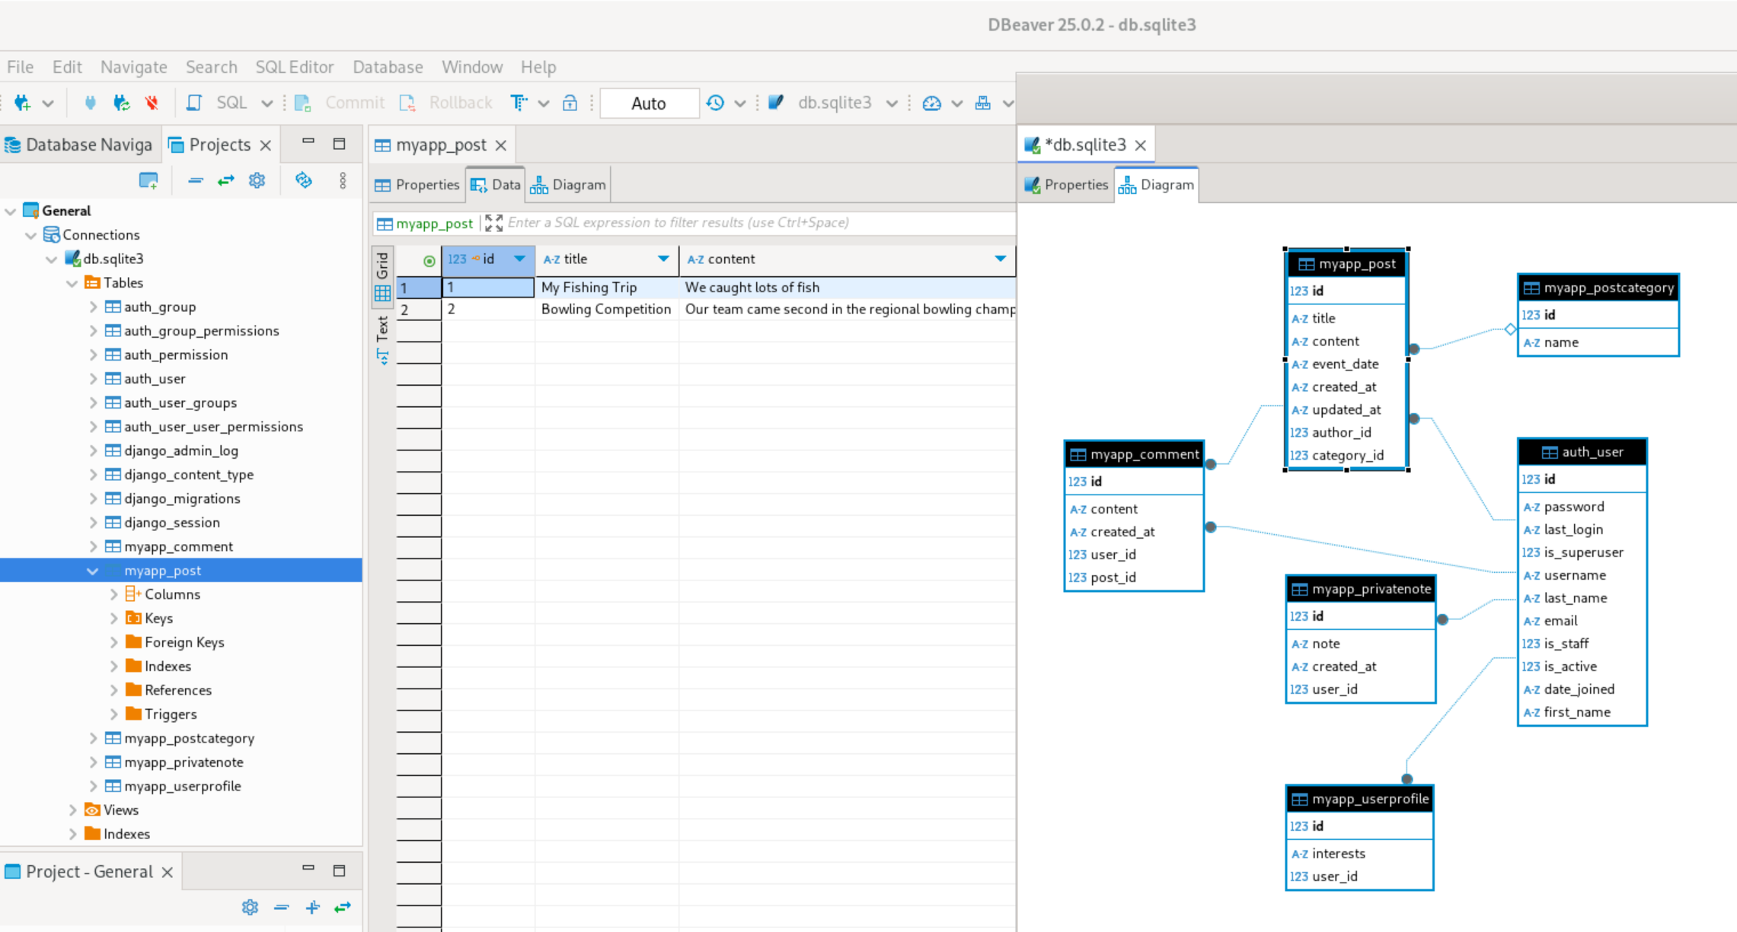
View db.sqlite3 in DBeaver
To generate an SQL Entity Relationship diagram:
Rightclick on db.sqlite3 → press “View Diagram”
In the diagram, select and delete the built-in Django tables (except for auth_user) to leave you with just your application specific tables

Slide 16
Implementing Assignment
Part 2: HTML Views
Add your application HTML and Logic:
Copy in your existing work from previous assignments
  HTML into the "myapp/templates/myapp" folder
    (Optional: move shared/duplicate HTML to “base.html” template)
  CSS into “myapp/static/myapp/css”
  Javascript files into "myapp/static/myapp/js”
Create simple template rendering views in "myapp/views.py" and "myapp/urls.py" for each of your existing pages.
Update your View code and HTML Templates to read and display data from the database Models.
Add Form classes and POST request handling views to handle form input from HTML, which create/update/delete database entries using the Models.
See the example projects on the Loop page for examples of typical straightforward Django functionality.

Slide 17
Example View – Displaying data
Display a list of entries from the database
# myapp/urls.py
app_name='myapp'
urlpatterns = [
# …
path('authors/', views.author_list, name='author_list'),
]
# myapp/views.py
from .models import Author
def author_list(request: HttpRequest):
authors = Author.objects.all()
context = {
'list_of_authors': authors
}
return render(request, 'myapp/author_list.html', context)
# myapp/templates/myapp/author_list.html
<h1>Authors</h1>
{% for author in list_of_authors %}
<li>
Name: {{ author.name }, Born: {{ author.birthday }}, From: {{ author.nationality }}
<a href="{% url 'myapp:author_detail' author.id %}”>Link</a>
</li>
{% endfor %}

Slide 18
Example View – Displaying data
Displaying data about an individual entry
# myapp/urls.py
app_name='myapp'
urlpatterns = [
# …
path('authors/<int:author_id>/', views.author_detail, name='author_detail'),
]
# myapp/templates/myapp/author_detail.html
<h1>Author Details</h1>
Name: {{ author.name }}<br>
Date of Birth: {{ author.birthday }}<br>
Nationality: {{ author.nationality }}<br>
<a href="{% url 'myapp:author_edit' author.id %}">Edit</a>
<a href="{% url 'myapp:author_delete' author.id %}">Delete</a>
<h2>Biography</h2>
<p>{{ author.bio }}</p>
<h2>Books by this author</h2>
{% for book in author_books %}
<li>
"{{ book.title }}", published {{ book.year }}.
</li>
{% endfor %}
# myapp/views.py
def author_detail(request: HttpRequest, author_id: int):
author = get_object_or_404(Author, id=author_id)
author_books = Book.objects.filter(author=author)
context = {
'author': author,
'author_books': author_books
}
return render(request, 'myapp/author_detail.html', context)

Slide 19
Example View – Creating entries using POST requests
Using Django’s “forms.Form” class for server-side deserialization and validation
# forms.py
class NewAuthorForm(forms.Form):
name = forms.CharField(
max_length=100,
widget=forms.TextInput(attrs={'class': 'myfieldclass'}),
label='Title')
birthday = forms.DateField(
widget=forms.DateInput(attrs={'class': 'myfieldclass',
'type': 'date'}),
label='Date of Birth')
nationality = forms.CharField(
max_length=100,
widget=forms.TextInput(attrs={'class': 'myfieldclass',
'placeholder': 'Enter Nationality'}),
label='Nationality'
)
# myapp/urls.py
app_name='myapp'
urlpatterns = [
# …
path('authors/new', views.author_create, name='author_create'),
]
# myapp/templates/myapp/author_create.html
<h1>Create a new Author</h1>
<form action="{% url 'myapp:author_create' %}" method="post">
{% csrf_token %}
{{ form.non_field_errors }}
<div>
<label for="id_name">Name:</label>
{{ form.name }}
{{ form.name.errors }}
</div>
<div>
<label for="id_content">Date of Birth:</label>
{{ form.birthday }}
{{ form.birthday.errors }}
</div>
<div>
<label for="id_content">Nationality:</label>
{{ form.nationality }}
{{ form.nationality.errors }}
</div>
<input type="submit" value="Submit">
</form>
# myapp/views.py
def author_create(request: HttpRequest):
if request.method == 'POST':
form = NewAuthorForm(request.POST)
if form.is_valid():
new_author = Author.objects.create(
name = form.cleaned_data['name'],
birthday = form.cleaned_data['birthday'],
nationality = form.cleaned_data['nationality'],
)
return redirect('myapp:author_list')
else:
form = NewAuthorForm()
context = {
'form': form
}
return render(request, 'myapp/author_create.html', context)

Slide 20
Manual HTML for the previous form
(If you don’t like using Django’s built-in form field HTML templating*)
# myapp/templates/myapp/author_create.html
<h1>Create a new Author</h1>
<form action="{% url 'myapp:author_create' %}" method="post">
{% csrf_token %}
{{ form.non_field_errors }}
<div>
<label for="id_name">Name:</label>
<input type="text" name="name" class="myfieldclass"
placeholder="Enter Post Title" maxlength="100" required id="id_name">
{{ form.name.errors }}
</div>
<div>
<label for="id_content">Date of Birth:</label>
<input type="date" name="birthday" class="myfieldclass" required id="id_birthday">
{{ form.birthday.errors }}
</div>
<div>
<label for="id_content">Nationality:</label>
<input type="text" name="nationality" class="myfieldclass" placeholder="Enter Nationality"
maxlength="100" required id="id_nationality">
{{ form.nationality.errors }}
</div>
<input type="submit" value="Submit">
</form>
Handwritten HTML form input fields like above are a little easier to style, but it can make some parts of form rendering more difficult:
Setting initial values for “Edit” forms, must be manually included using “<input …. value={{ author.name}}”>”
forms.ModelChoiceField “<select> drop-down for ForeignKey references is easy to use with “{{ form.myfield }}”, but to implement manually using plain HTML, you would need a {% for %} loop to iterate a list of options to manually generate the <option> HTML.

Slide 21
Example View – Editing an existing entry
Similar to Create forms, except with “initial” data from from existing object
# myapp/forms.py
class EditAuthorForm(forms.Form):
bio = forms.CharField(
required=False,
widget=forms.Textarea(
attrs={'class': 'myfieldclass'}),
label='Biography'
)
nationality = forms.CharField(
max_length=100,
widget=forms.TextInput(
attrs={'class': 'myfieldclass'}),
label='Nationality'
)
# myapp/urls.py
path('authors/<int:author_id>/edit/', views.author_edit, name='author_edit'),
# myapp/views.py
def author_edit(request: HttpRequest, author_id: int):
author = get_object_or_404(Author, id=author_id)
if request.method == 'POST':
form = EditAuthorForm(request.POST)
if form.is_valid():
author.bio = form.cleaned_data['bio']
author.nationality = form.cleaned_data['nationality']
author.save()
return redirect('myapp:author_detail', author.id)
else:
initial = {
'bio': author.bio,
'nationality': author.nationality,
}
form = EditAuthorForm(initial=initial)
context = {
'author': author,
'form': form
}
return render(request, 'myapp/author_edit.html', context)
# myapp/templates/myapp/author_edit.html
<h1>Edit Author: {{ author.name }}</h1>
<form action="{% url 'myapp:author_edit' author.id %}"
method="post">
{% csrf_token %}
{{ form.non_field_errors }}
<div>
<label for="id_bio">Biography:</label>
{{ form.bio }}
{{ form.bio.errors }}
</div>
<div>
<label for="id_content">Nationality:</label>
{{ form.nationality }}
{{ form.nationality.errors }}
</div>
<input type="submit" value="Submit">
</form>

Slide 22
Debugging views.py
Use Web Browser F12 “Network” tab to view HTTP Request and HTTP Response
Add print(…) statements in the Python code, e.g.
  print(“Now in myview()”)
  print(“Method: “, request.method)
  print(“POST: “, request.POST)
Use Visual Studio Code breakpoints

